Slide 1
Event
Handling

Slide 2
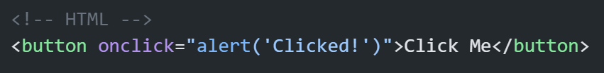
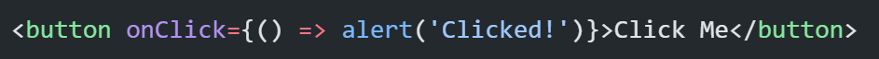
HTML vs React Events
Key Differences:
React uses camelCase (onClick, onChange, etc.)
Pass a function reference, not a string
React events work across browsers using SyntheticEvent (React’s wrapper)

Slide 3
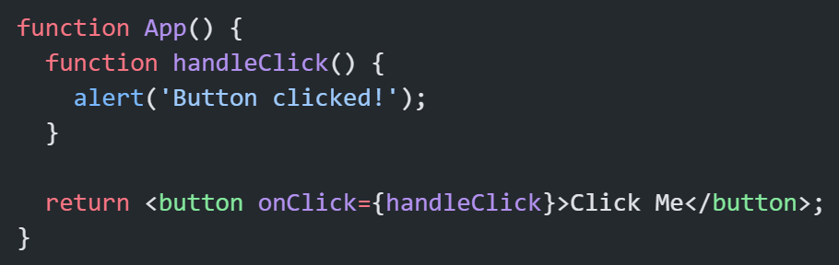
Event Handler Basics
Handle basic events like click, change, and submit.
Common Events:
onClick
onChange
onSubmit
onMouseEnter / onMouseLeave
onKeyDown / onKeyUp

Slide 4
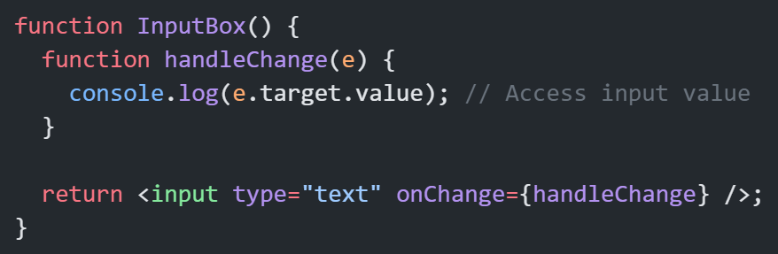
Accessing Event Object

Slide 5
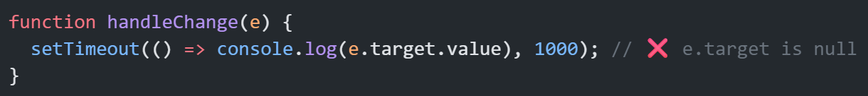
SyntheticEvent:
Event handling in React follows a similar pattern to standard javaScript event handling but with some key differences, such as using synthetic events for cross-browser compatibility and providing consistent event handling across different elements and browsers.
When you handle events in React, like clicking a button or typing in an input box, React wraps the native browser events in something called Synthetic Event. This Synthetic Event ensures consistent event handling across different browsers.
But after the event handler runs, React pools the event for performance (so e.target may become null in async code).
In React 16 and later versions, this problem is no more.

Slide 6
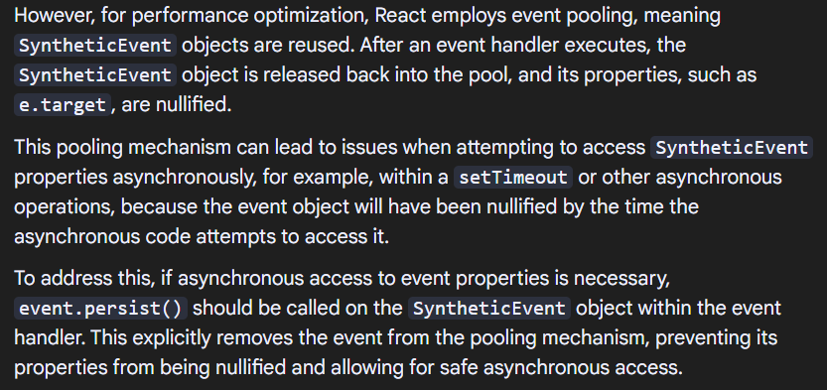

Slide 7
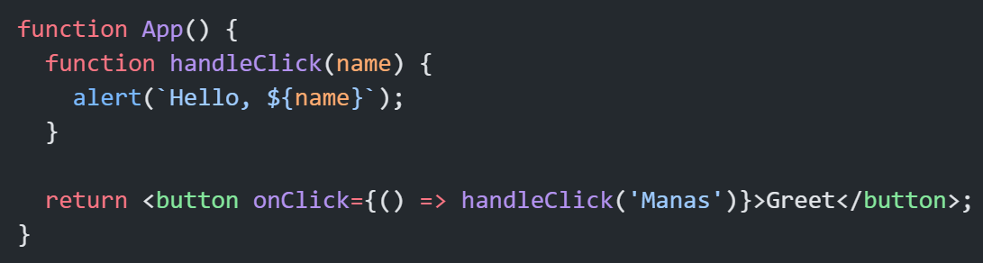
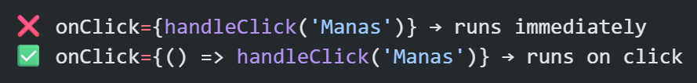
Passing Arguments to Handlers
Beginner Mistake:

Slide 8
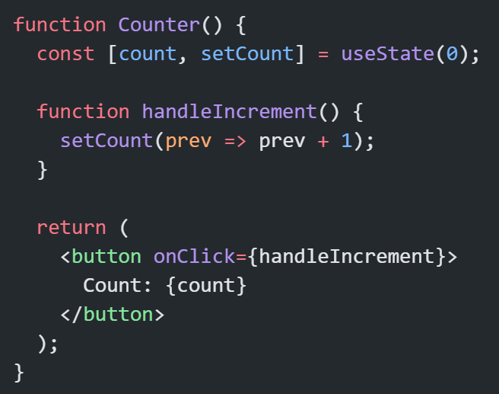
Using State with Events
React re-renders on setState
Event handlers capture the current state snapshot
Pitfall: State updates are asynchronous, so never rely on immediate new values.

Slide 9
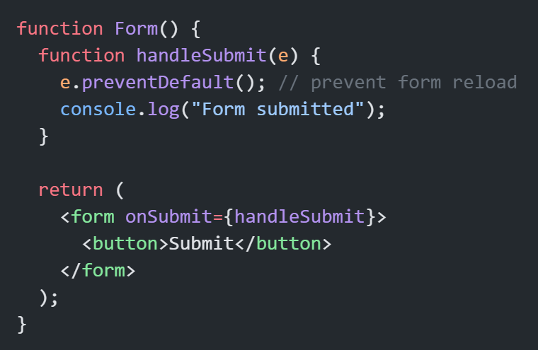
Prevent Default & Stop Propagation
Prevent Default

Slide 10
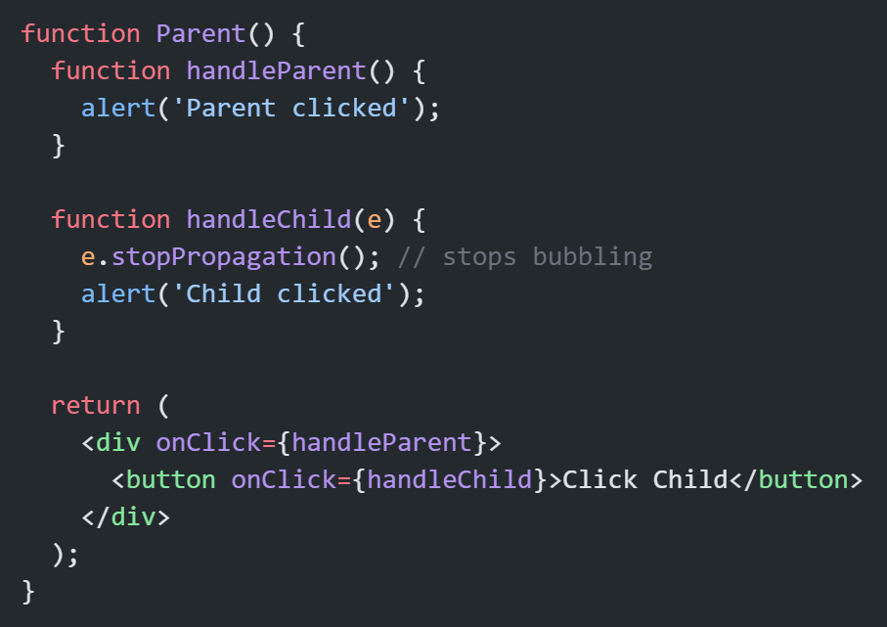
Stop Propagation

Slide 11
Common Beginner Mistakes Recap
Mistake | Why it Happens | Fix
Calling handler immediately | Using onClick={fn()} | Use arrow function
Losing event object | React pools SyntheticEvent | Use React 16 or 16+
Forgetting e.preventDefault() | Form reloads on submit | Call it inside handler
Using state directly after setState | State update is async | Use callback or useEffect
Not stopping event bubbling | Both parent & child trigger | Use e.stopPropagation()

Slide 12
Thank You

